Slide 1

EXPLORING THE POTENTIAL OF
Ankitha Pilli
160115733122
Mentor
Dr. K. Sagar

Slide 2
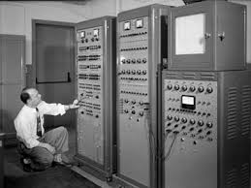
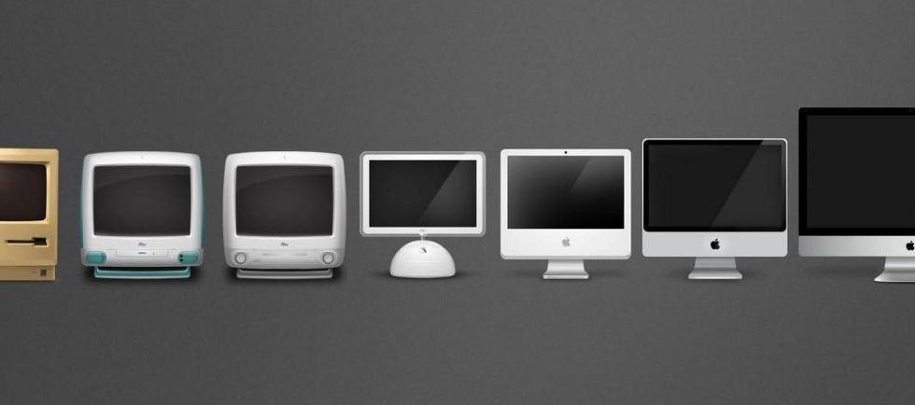

Slide 3
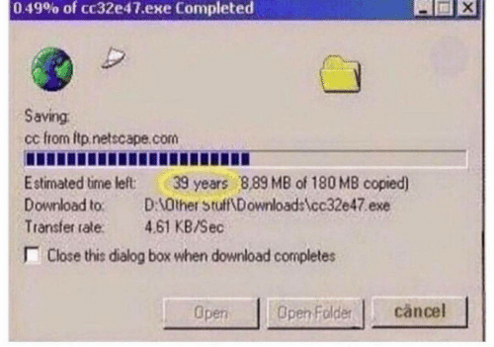
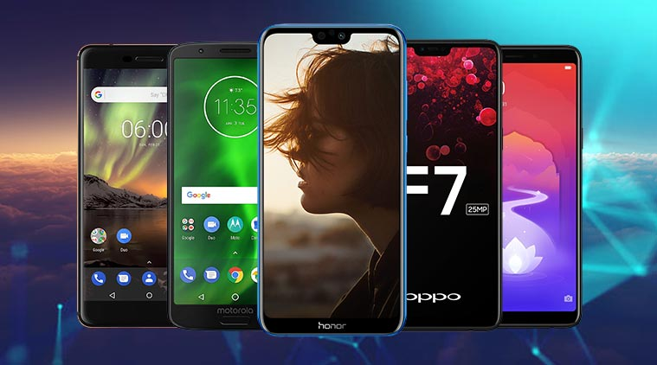
Notes:
Moore’s Law — a law that tells us that computer power doubles about every 18 months.
2. computer chips are made of basic modules which are made of logic gates which are, in turn, a combination of transistors.
3. These simple little components are essential for all our electronics and the great news is, the smaller we make them, the faster they’ll be while consuming less energy. That’s why transistors now are approaching the size of a single atom

Slide 4
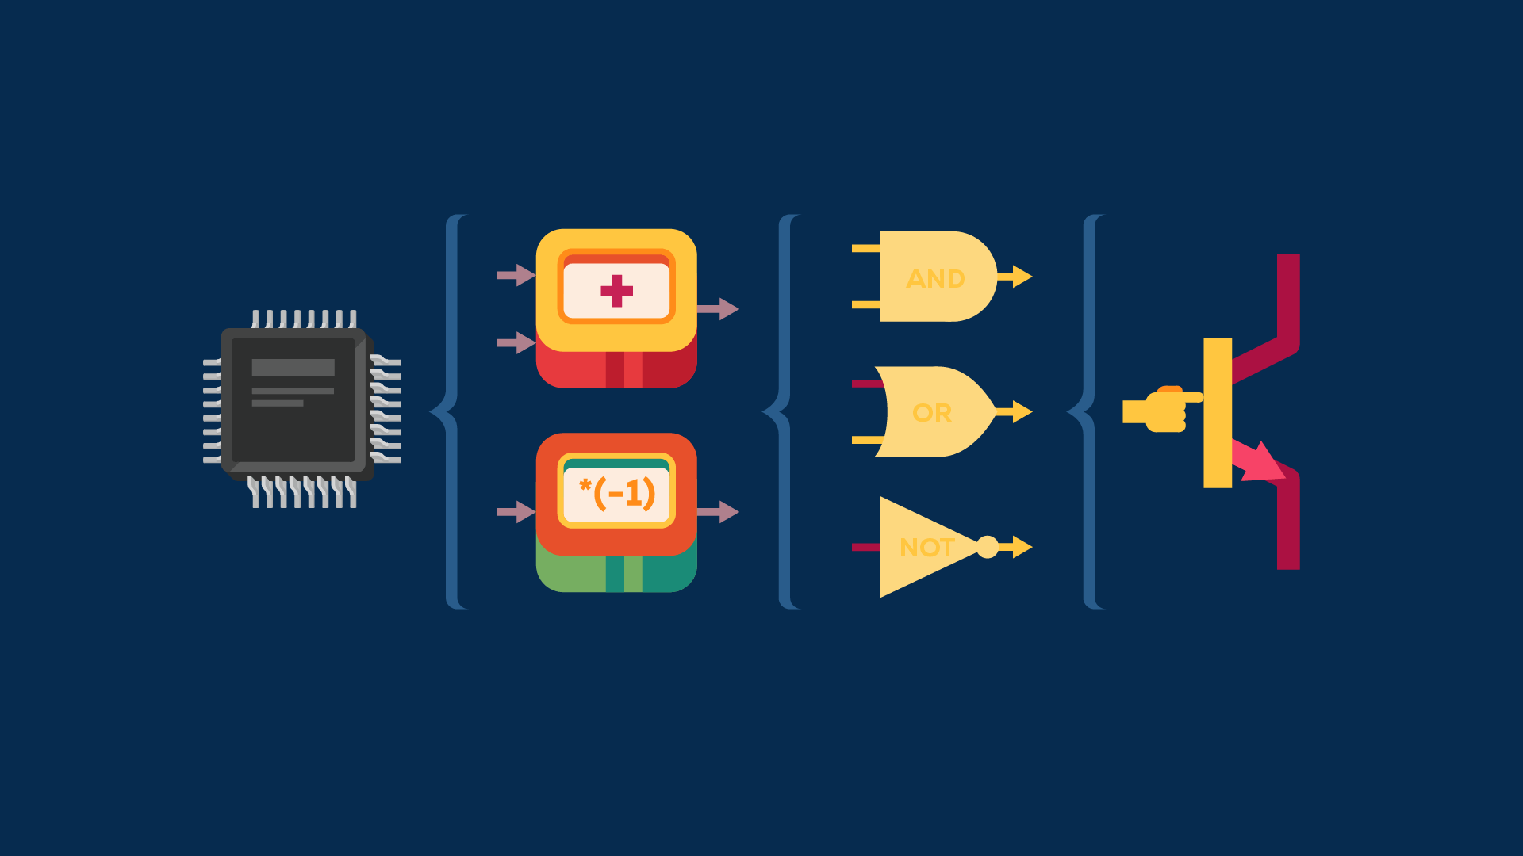
Notes:
regular transistor present in ever y modern computer or device. It operates by directing large clouds
of carriers of electrical current using engineered materials and quantum-based principles

Slide 5
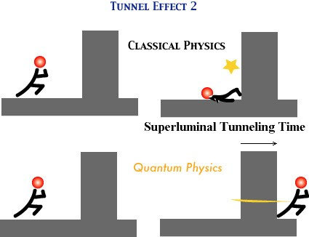
QUANTUM TUNNELING
Notes:
So this microcope uses "magical" quantum tunnel effect ?
But it's natural that when two atoms get so close to each other, an electron can move into another atom from realistic (= classical ) viewpoint.

Slide 6
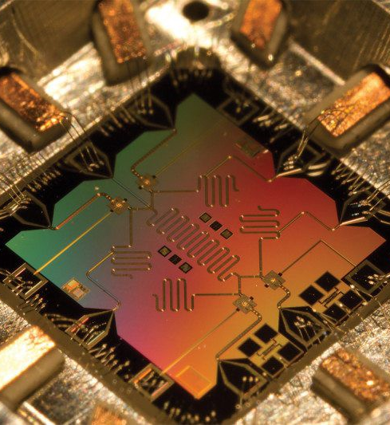
QUBITS
(quantum bits which can be made using a photon, an electron, or a nucleus)
Notes:
The idea behind quantum computers is to take these phenomena of the quantum realm and use it to our advantage to create better machines.

Slide 7

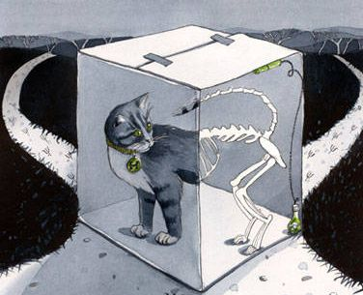
QUANTUM SUPERPOSITION
Notes:
Think of a qubit as an electron in a magnetic field. The electron's spin may be either in alignment with the field, which is known as a spin-up state, or opposite to the field, which is known as a spin-down state.

Slide 8
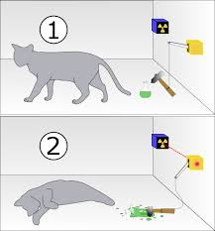
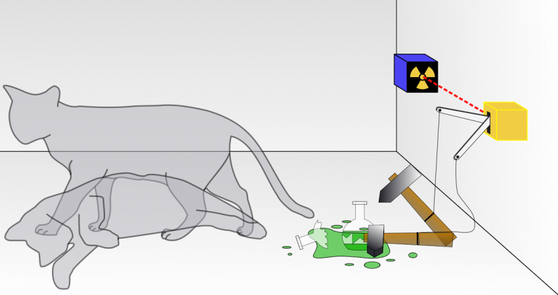

Slide 9
0 and 1
0 and 1
0 and 1
A | B | C 0 | 0 | 0 0 | 0 | 1 0 | 1 | 0 0 | 1 | 1 1 | 0 | 0 1 | 0 | 1 1 | 1 | 0 1 | 1 | 1
A | B | C | Score 0 | 0 | 0 | -1 0 | 0 | 1 | 1 <- one of the best solutions 0 | 1 | 0 | -1 0 | 1 | 1 | -1 1 | 0 | 0 | -1 1 | 0 | 1 | -1 1 | 1 | 0 | 1 <- the other best solution 1 | 1 | 1 | -1
So, if there are 100 people, we’ll need to go through:
2¹⁰⁰ ~= 10³⁰ = one million million million million million configuration
Notes:
you apply some sort of computation on these three qubits, you are actually applying the same computation in all of those 8 parallel worlds at the same time.
You would need to give your quantum computer two things:
All potential solutions represented with qubits
A function that turns each potential solution into a score. In this case, this is the function that counts the numbers of friend pairs and enemy pairs sharing the same car.
Given these two things, your quantum computer will spit out one of the best solutions in a few milliseconds. In this case, that’s 001 or 110 with a score of 1.

Slide 10


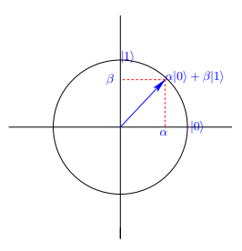
A qubit or quantum bit is a quantum system whose state can be fully described by a superposition of two orthonormal eigenstates labeled and .
The general state of a qubit is given by
Notes:
Hilbert space

Slide 11
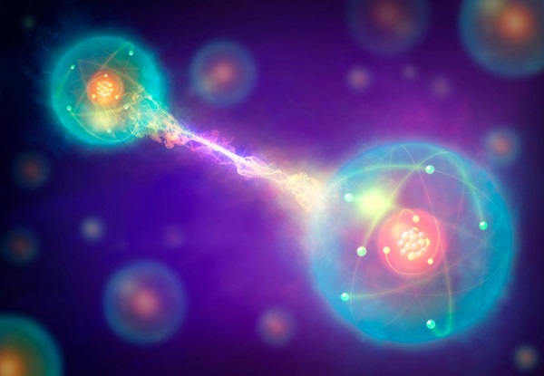
QUANTUM ENTANGLEMENT
spooky action at a distance
Quantum entanglement allows qubits that are separated by incredible distances to interact with each other instantaneously (not limited to the speed of light).
Notes:
Particles that have interacted at some point retain a type of connection and can be entangled with each other in pairs, in a process known as correlation. Knowing the spin state of one entangled particle - up or down - allows one to know that the spin of its mate is in the opposite direction. Even more amazing is the knowledge that, due to the phenomenon of superposition, the measured particle has no single spin direction before being measured, but is simultaneously in both a spin-up and spin-down state. The spin state of the particle being measured is decided at the time of measurement and communicated to the correlated particle, which simultaneously assumes the opposite spin direction to that of the measured particle. This is a real phenomenon (Einstein called it "spooky action at a distance"), the mechanism of which cannot, as yet, be explained by any theory - it simply must be taken as given. No matter how great the distance between the correlated particles, they will remain entangled as long as they are isolated.

Slide 12

A quantum computer is used to direct a
radiation beam that destroys the cancer cells with extreme precision and spares all surrounding tissue*.
*Solenov, Dmitry et al. “The Potential of Quantum Computing and Machine Learning to Advance Clinical Research and Change the Practice of Medicine”Missouri medicine vol. 115,5 (2018): 463-467.
Notes:
The quantum imaging software identified a 1/10th mm square cluster of cancer cells near her original surgery
This rapid detection of a tiny cluster of cancer cells and their destruction is one of many
potential advances in medicine that could occur pending the realization of quantum computing.

Slide 13

The computational power to generate diagnoses in real time or to increase the precision of imaging to detect early stages of cancer may soon push beyond the limits of the standard binary 0/1 system available to Watson.
Notes:
Q#
Private industry (Google, IBM, etc.) and government agencies are already investing into quantum computing and artificial
intelligence systems to make this happen.

Slide 14
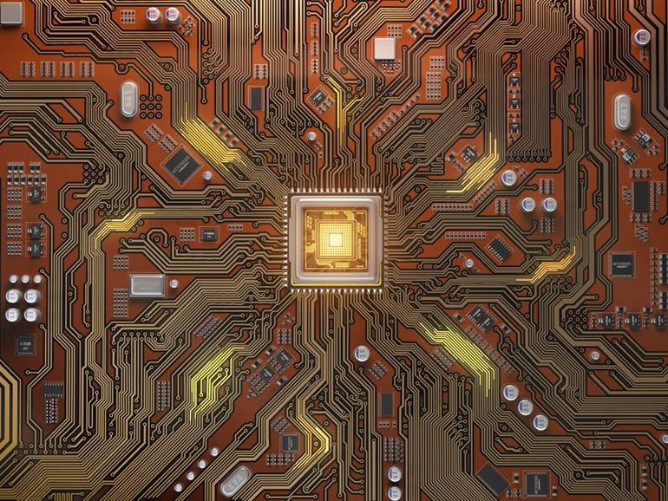
Quantum Cryptography
Cryptography is expected to be the first application of quantum computing to enter medical practice to secure medical records and communication.
Notes:
It defends state secrets, and the corporate sort. It protects financial flows and medical records. And it makes the $2trn e-commerce industry possible. Without it, credit-card details, bank transfers, emails and the like would zip around the internet unprotected, for anyone so minded to see or steal
An important exception is one area of quantum computing - quantum cryptography. With significant government investments (NSA,
DOD, DOE), quantum cryptography is being already used to secure communications.14-16 Standard encryption methods rely on a keycode for the user to access encrypted data. However, the key must be shared and can be decoded by unauthorized persons
seeking to ‘hack’ a system. With quantum computing, the key and the data can be secured indefinitely with
guaranteed unbreakable encryption. Such strong security is possible because quantum encryption
relies on the laws of nature (quantum mechanics) to furnish it.

Slide 15
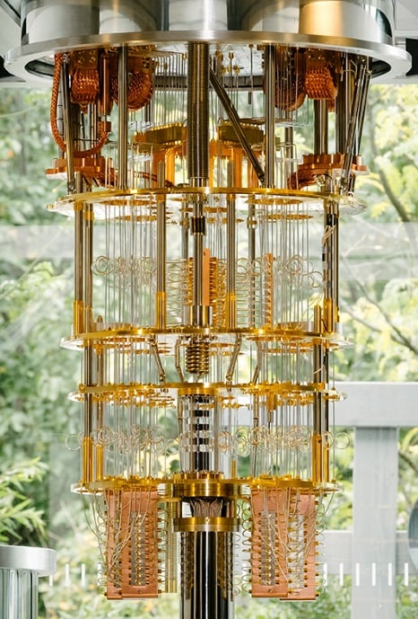
Can you buy a quantum computer?
Notes:
No! points out that quantum computers need lots of coddling. Most must be cooled to a temperature close to absolute zero. This means that, for the foreseeable future, access to them will be sold as a cloud-computing service in which users rent time from the machines’ owners.
A key challenge for quantum computers is to provide and maintain isolation of individual quantum particles (qubits) involved in computation.
Extreme and stable cooling is required to make wire circuits (or circuits made of other materials) behave in a quantum fashion.

Slide 16
Can we shift completely?
Notes:
As chips migrate into everything from cars and children’s toys to lighting systems and smart electricity meters, the amount of work will only grow.
All this means that quantum-proofing the internet is shaping up to be an expensive, protracted and probably incomplete job

Slide 17

Notes:
. In terms of modeling processes in nature, like photosynthesis, our computers can’t
do that at all because nature encodes its information in quantum mechanics. It takes a quantum machine to model quantum events.
We may be at the dawn of a revolution in computing. At this time we can only point to experiments and speculate how quantum computing could improve imaging, diagnosis, treatment, and population health. It is yet to be determined if and
when quantum computers will be accessible for daily use in medicine and research. We have numerous
examples of machine learning algorithms and artificial intelligence that may leverage the power of quantum
computing to deliver real time results. Until this level of access is available, quantum computing will
remain the domain of researchers, not physicians.

Slide 18
REFERENCES
[1] Solenov, Dmitry et al. “The Potential of Quantum Computing and Machine Learning to Advance Clinical Research and Change the Practice of Medicine”Missouri medicine vol. 115,5 (2018): 463-467.
[2] Prathamesh Ratnaparkhi, B. K. Behera, and P. K. Panigrahi, “Getting Started With Quantum Computation: Experiencing The Quantum Experience,” Unpublished, 2018. doi: 10.13140/RG.2.2.24079.23207
[3] A. Frisch, "IBM Q — Introduction into quantum computing with live demo," 2017 30th IEEE International System-on-Chip Conference (SOCC), Munich, 2017, pp. 1-2. doi: 10.1109/SOCC.2017.8225985

Slide 19


Slide 20


